Slide 1
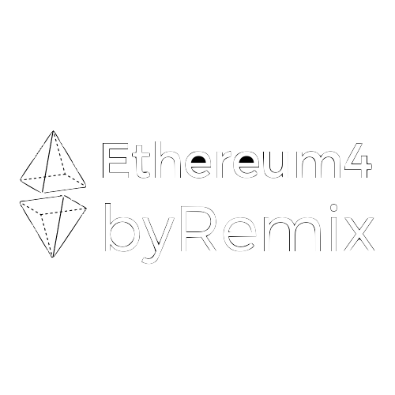

Ethereum 4 Lawyers
-workshop-

Slide 2
CHECK-IN
Introduce Yourself
Metamask wallet address

Slide 3
Where bureaucracy becomes a problem
Notes:
LUIGI

Slide 4
Public Administration’s random behavior
→ bureaucracy decision-making gauntlets → document accessibility and digitization of records → delays in payments → corruption
Notes:
LUIGI

Slide 5
2. slow and expensive Courts → organizational deficits → cost of litigations
Notes:
LUIGI

Slide 6
3. E-commerce dispute resolution → lack of integrated ODR (online dispute resolution)
Notes:
LUIGI

Slide 7
4. General Copyright and Trademark interoperability → “once over” principle not always respected
Notes:
LUIGI

Slide 8
5. high cost of notarizations → proving ownerships → proving authentication of private contracts
Notes:
LUIGI

Slide 9
6. Ownership Registries are limited in scope and subject matters → not all assets are currently tracked → associated transfer of risk → who owns the datasets? → bureaucracy and costs of updating associated registries
(e.g. you can’t register the ownership of the house if the land is not registered)
Notes:
LUIGI

Slide 10
7. Little use of digital signature → “self-sovereign identity” principle not represented by state agencies → Campaigns, platforms wanting to use the digital signature have to pay a very high price-per-user (set by state agencies, recharged by service providers) → Digital signature service providers are centralized
Notes:
@LUIGI

Slide 11
ETHEREUM
→ Database - Spreadsheet: Saving information and softwares (smart contracts)
→ Bank Account: Saving info in a way that info can only be added not modified
→ World Computer: for running computations & algorithms
Notes:
@ROB

Slide 12









WEB2 Apps
APPS
CENTRALIZED
CENSURABLE
DATA-TAMPERING
OPAQUE
TermsofService-based TRUST
PUBLIC
INTERNET
Notes:
ROB Your personal data is monetized because it is under the control (and in the private databases) of the large players.

Slide 13



Centralization can be efficient but can have side effects...
APP / CENTRAL AUTHORITY
RESULT
FINANCE
DECISION MAKING
BROADCASTING
NETWORKING
DELINQUENCIES
MANIPULATION
CENSORSHIP
DATA TAMPERING
Notes:
ROB

Slide 14

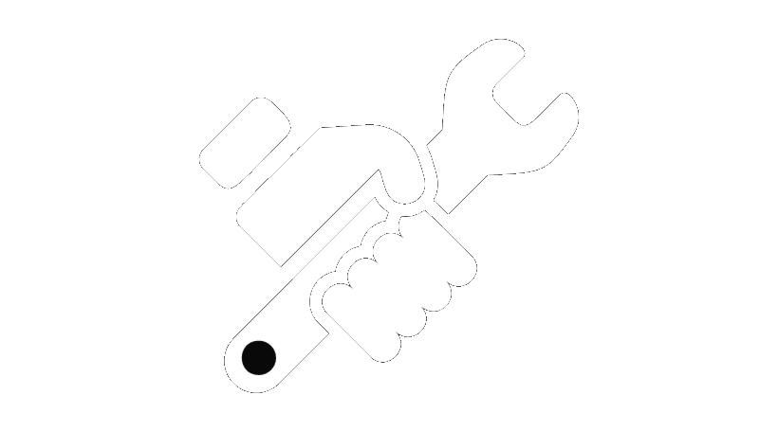


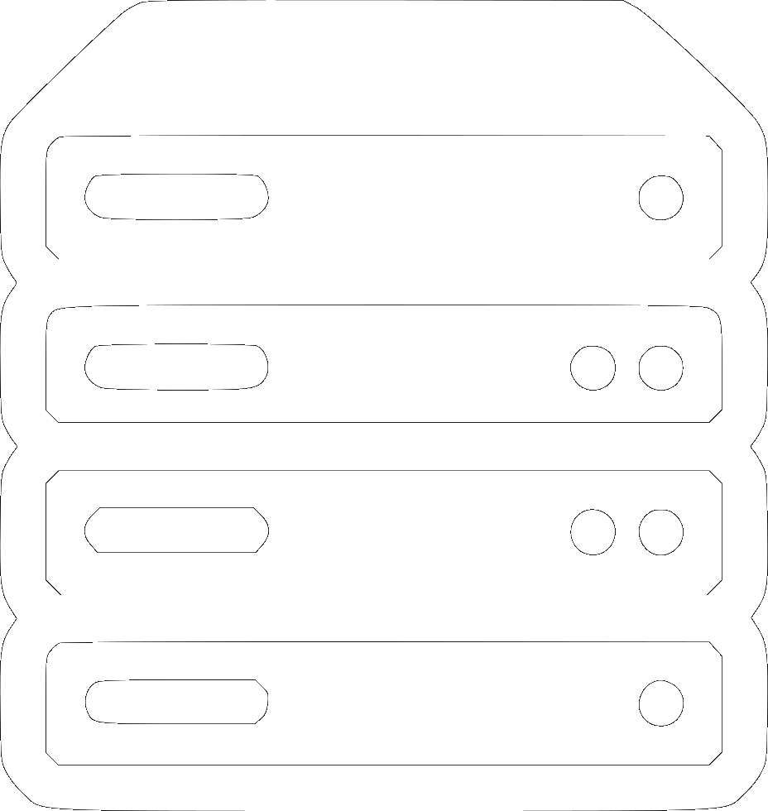

Online Voting: a visual representation
Notes:
ROB is this about centralized online voting?

Slide 15

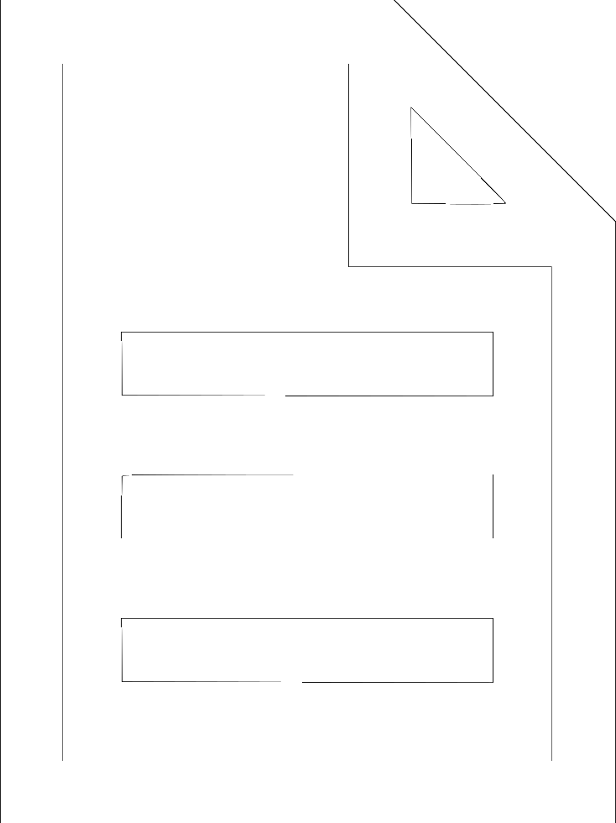
WEB3: Public Info Storage & Computation
Nodes
DAPP
DECENTRALIZED
UNCENSORABLE
TRANSPARENT
TRUSTLESS
Smart Contracts
DAPP
DAPP
Info storage
DAPP
PUBLIC
BLOCKCHAIN
Notes:
ROB

Slide 16
Txn From To Value Data
0xa4...
Luigi
Frank
1
Thanks
Block N
0xa5...
Alice
Bob
0.5
Paid
0xa6...
Bob
Sam
2
0xa7...
Chiara
Contract
0
Vote for #1
Block N+1
0xa8...
Rob
Contract
0
Vote for #2
0xa9...
Carlo
Matteo
12.5
ricevuto!
0xa10...
Leo
Contract
0
vote
Block N+2
Notes:
ROB

Slide 17
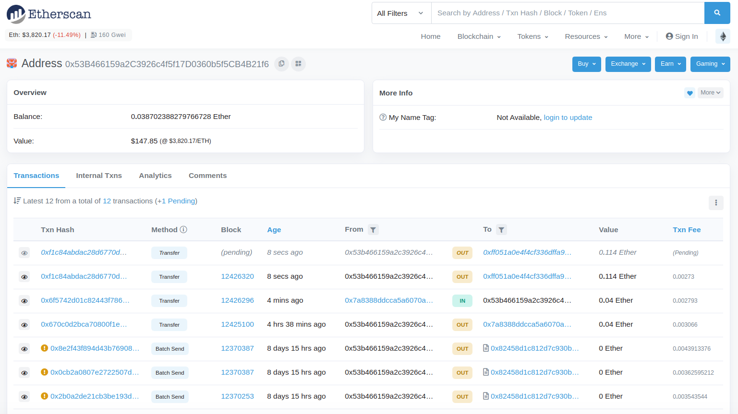
Notes:
ROB

Slide 18
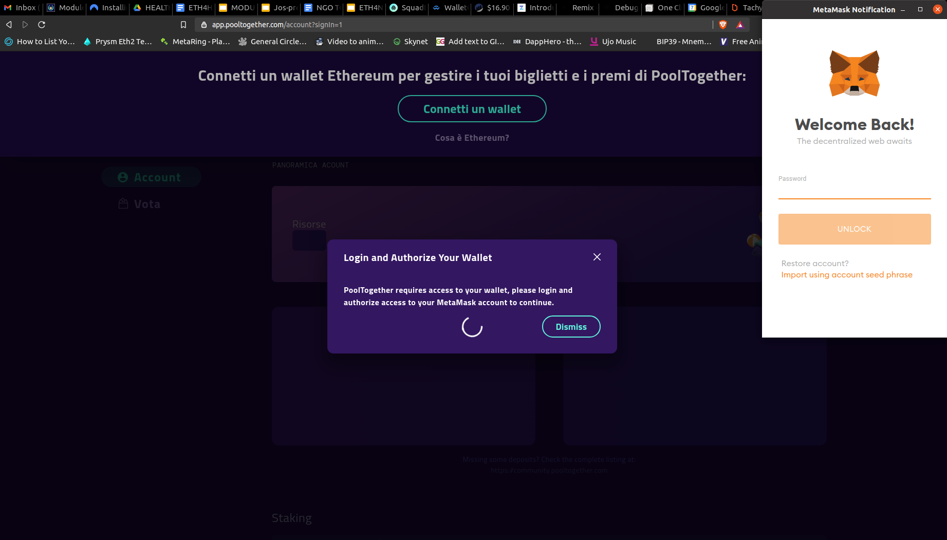
How to access the blockchain?
A DApp will read and write to the blockchain
The DApps needs you to save data to the chain, you will need to pay fees - so you’ll need a wallet.
A DApp in a browser will typically use
the metamask wallet
(a browser extension)
Notes:
Update this slide

Slide 19
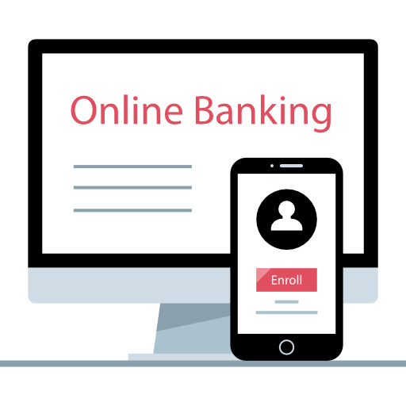
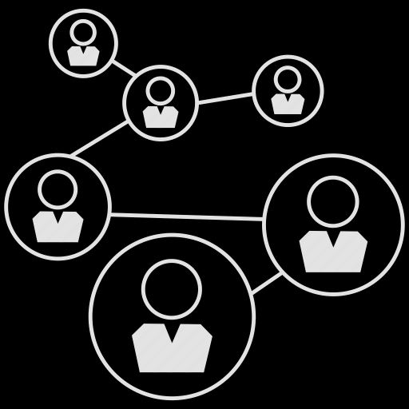

Social and Finance on the Internet
WEB 2
WEB 3
PROFILE
ACTIVITY
ACCOUNT
TRANSACTIONS
Rob’s Wallet
0x123abc...789a4b
PROFILE is ACCOUNT
ACTIVITIES are TRANSACTIONS
Pseudo-Anonymity
Digital Signature
Password Responsibility
Notes:
Web3 def

Slide 20

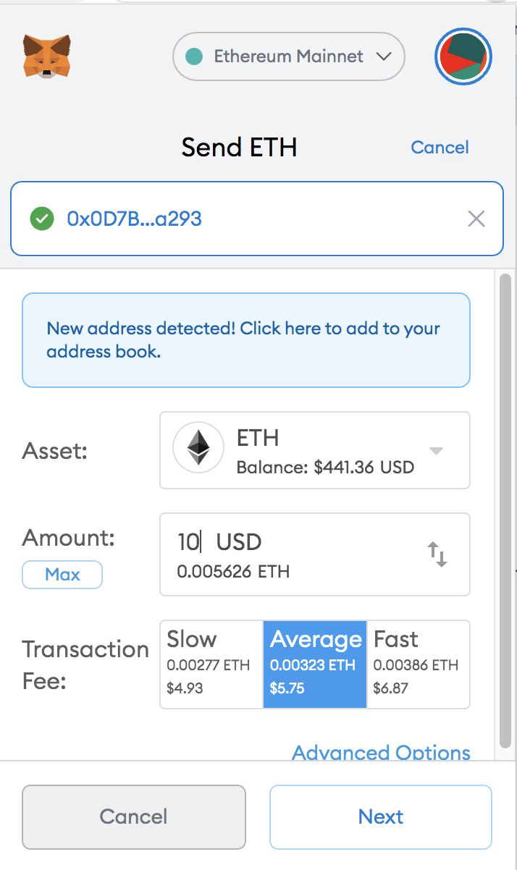
ETHER (ETH)
Is the native token of the Ethereum Blockchain
Miners get paid in Ether to glue (validate) the blocks together
In order to interact with the Ethereum Blockchain, you need a personal balance of ETH, because the Ethereum network charges you (in “Gas”) for:
saving information
computing

Slide 21
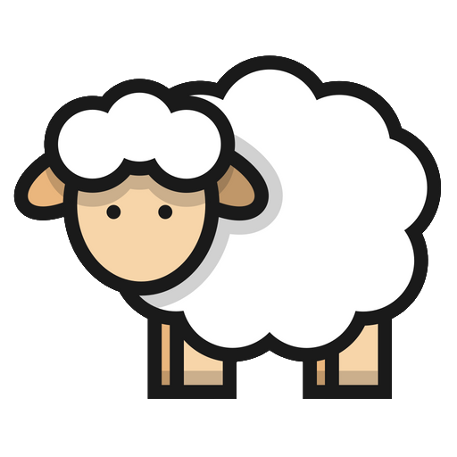
SMART CONTRACTS CAN SAVE INFO (REGISTRY)
software that runs on the blockchain = public and decentralized. It contains a list of rules.
EXAMPLE
I am a shepherd.
I want to save my sheep in a list that:
shows I own them
is a public list
If I registered the sheep with my city, I would have to trust the city’s record keeper & their servers
Only the owner of a sheep can transfer its ownership to someone else. Everytime a sheep is sold, the new owner displays on the registry automatically (I don’t need a public functionary to update it)
ROB the SHEPHERD’s
SHEEP CONTRACT
0x05854cA140caB11e2f5AAb284c6AB5415f96E26B
Notes:
ROB

Slide 22
SMART CONTRACTS CAN HOLD MONEY
Used in Escrow and Multi-Signature Contracts
Contract can hold Ether or other tokens.
Rules are set up in the contract about what to do with the money.
Payable functions / receive()
Rules can be set and voted on how that money is managed
Roles can be given to specific addresses (EOAs or other contracts)
Notes:
ROB -

Slide 23



ERC20 - FUNGIBLE TOKENs
Custom money
Token Standard (same base Smart Contract)
Contains the lists of Value Holders’ Addresses
They are “fungible” and “swappable”
(e.g. 10 tokens of Project A can be exchanged for 2 tokens of Project B)
Many startups use these tokens to:
govern their Decentralized Apps (DApps)
raise funds
Notes:
ROB when I send a token to you - it looks like I just dropped it into your wallet - but actually I am going to the to token’s contract and telling it that I send the token to you. The token’s contract keeps track of the flow of that token.

Slide 24

ERC721 - NON FUNGIBLE TOKENs (NFTs)
Each token is unique
The token can represent ownership of copyrights / royalties / licenses / tickets, anything that the Author associated with the NFT
An example rule: The Author can receive royalties every time the NFT is sold on the secondary market
QUESTION: What does it mean to own a digital thing?
Who owns it
NFT
Address of artwork on IPFS
Rules: eg: like 10% of resales go to original creator
Notes:
ROB (end of this part)

Slide 25
Basics of a Smart Contract
Notes:
MAT

Slide 26
Language
→ from readable programming language (e.g. Solidity) to OpCodes to Machine Code (bytecode)
→ code language is usually annotated with natural language comments
→ In Solidity there is Natspec - more than normal code comments these comments get saved in the compiled contract’s metadata
Notes:
MAT

Slide 27
Deployer / Owner
→ the deployer’s address often has specific permissions & privileges (ownable.sol contract / ‘onlyOwner’ modifier)
→ responsibilities entailed by contract ownership
→ what is the value of a DAO contract with a permissioned Owner?
Notes:
MAT - I’m a bit confused still about this slide(ROB -writing)

Slide 28
Functions
→ write on / read from the Blockchain
→ running functions on smart contracts can have specific checks (modifiers, require statements, if statements etc.)
→ functions can handle internal logic in a contract (private) or can be publicly accessible
Notes:
MAT

Slide 29
Deployment
→ a deployed contract is included in the chain and can be accessed by users as well as other contracts
→ a write function writes on the blockchain, requiring fees and gas, and once signed returns a transaction hash
Notes:
MAT - do you mean - after a contract is deployed and included in the chain, it can be …. uhhh used?

Slide 30
Signing
→ Sign something with your private key and there is a “result”
→ Someone else can use this “result” to derive your public key and what you signed - thus proving that you signed it with your private key.
Notes:
MAT

Slide 31
2_Owner.sol
Notes:
MAT

Slide 32
Defining a standard for Smart Legal Contract
Notes:
LUIGI

Slide 33
Smart contracts may be legal contracts themselves if they meet the requirements established by a given jurisdiction.
UK Jurisdiction Taskforce of the LawTech Delivery Panel, Consultation Paper May 2019: “A smart contract may or may not have legal ramifications as it is merely computer code, whereas a ‘smart legal contract’ refers to a smart contract that either is, or is part of, a binding legal contract.”
Notes:
LUIGI

Slide 34
Categorization by UK Jurisdiction Taskforce:
Solely Code Model: code standing by itself (without being housed within any form of natural language contractual architecture)
Internal Model: a contract written in a document comprising natural language and code
External Model: a contract entirely in natural language but including an agreement for certain aspects of the contract to be performed using a program designed for this purpose
Public Consultation Legal Statement
Notes:
LUIGI

Slide 35
Legal readability of the code and verification
Natspec
Use the ///@notice natspec tags (or simply ///), for example as @notice law etc. A wallet can use the NatSpec user documentation to display a confirmation message to the user whenever they interact with the contract, together with requesting authorization for the transaction signature
Custom tags: ///@custom:law (our proposal) to make legal citations
The contract will not compile if Natspec is not typed correctly, IT IS MORE THAN JUST A NOTE
Notes:
ROB / MAT → add @notice to Owner.sol

Slide 36
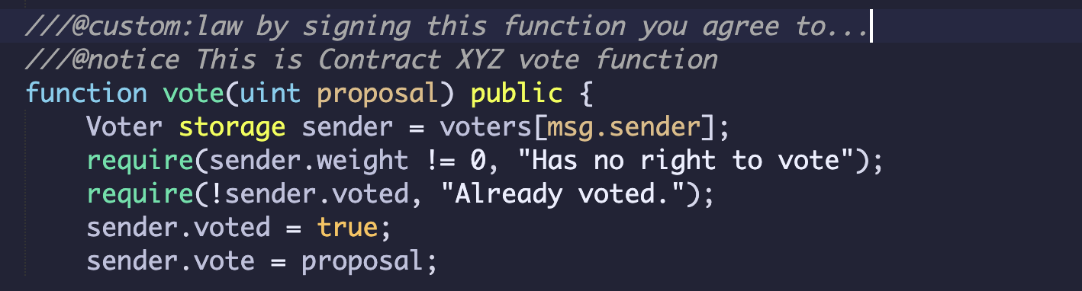
Notes:
ROB - @law setting up the rules for the parties of the contract - rules, rights & obligations (actual clause)
@notice - feels more like clarification

Slide 37
Sourcify.eth / Publish source code and metadata on IPFS
Lexon (article) http://demo.lexon.tech/
Notes:
ROB LEXON / A “person” in Lexon is “address payable” in Solidity; and “an amount” is “uint”. Makes sense, and it’s a lot of fun to see what’s going on under the hood
MAT Sourcify: the principle of contract verification → Sourcify is a database of smart contract’s source-code, so that people know what they are signing (if they can read the solidity code)

Slide 38
2. IDs and wallets A unique address associated to a unique ID, enforce KYC
Proof of humanity
Other Solutions: connect a wallet to the State-provided digital signature (is it possible?)
Notes:
ROB MAT

Slide 39
3. Multisignature Contracts for multi-party deals and transactions, joint ventures, shareholders meeting, supply chain, DAO governance, etc.
gnosis.safe demo
Notes:
ROB MAT LUIGI

Slide 40
What else makes a smart contract LEGAL?
Notes:
MAT

Slide 41
Defining a Modus Operandi for DAPPs

Slide 42
INTENTION
BUILDING AND ROLES
CONSTRAINTS
Notes:
LUIGI MAT

Slide 43
INTENTION
What is my project about?
e.g. NFTs as collaterals
What action does my DAPP enable?
e.g. 1) P2P trading of digital ownership certificates
What mis-behavior does it leave room for?
e.g. 1) people issuing certificates over digital or physical items they don’t have ownership or copyright on
Notes:
LUIGI MAT

Slide 44
ORGANIZATIONS AND ROLES
Should I use standard Smart Contracts? or hire someone to extend them?
What are the Roles and Limitations?
Contract Owner
Modifiers/Require functions
Promises and contract flexibility:
Contracts’ interoperability can be a problem (e.g. NGO tokens being ‘pooled’ by users)
Where should I implement ‘upgradable’ Proxy contracts?
What is the consensus mechanism of these proxy contracts?
Notes:
LUIGI MAT

Slide 45
Do I need to be custodian and enforce KYC - AML? Or can I respect anonymity and privacy?
Is self-sovereign ID enough for the dAPP’s purpose?
What does it represent? (utility, payment, security)
What is the token’s life cycle?
Hard governance or signaling?
ID
TOKEN
DATA
OWN
What data goes public?
Immutability vs Right to Be Forgotten
Is there off-chain data I should deal with? (e.g. Geolocation)
Are these data sensitive of IP?
Who owns what?
Are smart contracts enough to cover all the rights and obligations involved?
How is IP implemented?
Notes:
LUIGI MAT

Slide 46
Some Best Practices
Legal implications of crypto concepts // use right jargon
Publish (and update) wholesome whitepapers // fulfill community & customers’ awareness on the project
Deploy KYC verification, at least at front-end level
Deploy AML tools (e.g. updatable Whitelists/Blacklists for addresses who can interact with the contract)
Separate the deployment of smart contracts and front-end // have multiple front-ends (e.g. Liquidity Pools)
Make sure the front end is not meant to hijack behaviors towards a desired action, but equally represents all the functions of a given contract
Governance Tokens increase regulatory risk and liability: think twice if you need one
CREDITS Victor Charpiat @ EthCC - https://www.youtube.com/watch?v=X51iNXLAV4E&t=1651s
Notes:
LUIGI MAT

Slide 47
Assignment:
how would you use smart contracts to provide
legally-binding solutions in your jurisdiction?
#conceptualPrototypes
Notes:
Everyone

Slide 48
Registries
Escrow
Digital signatures
International trade
Corporate or public governance
Photo Timestamp / insurances
Notes:
MarriageContract
HABITAT or

Slide 49
OUR EXAMPLE Mary and John want to get married
but the city archive was hacked.
An officer is available for officing the ceremony
WeddingLedger.sol
Notes:
MarriageContract
HABITAT or

Slide 50
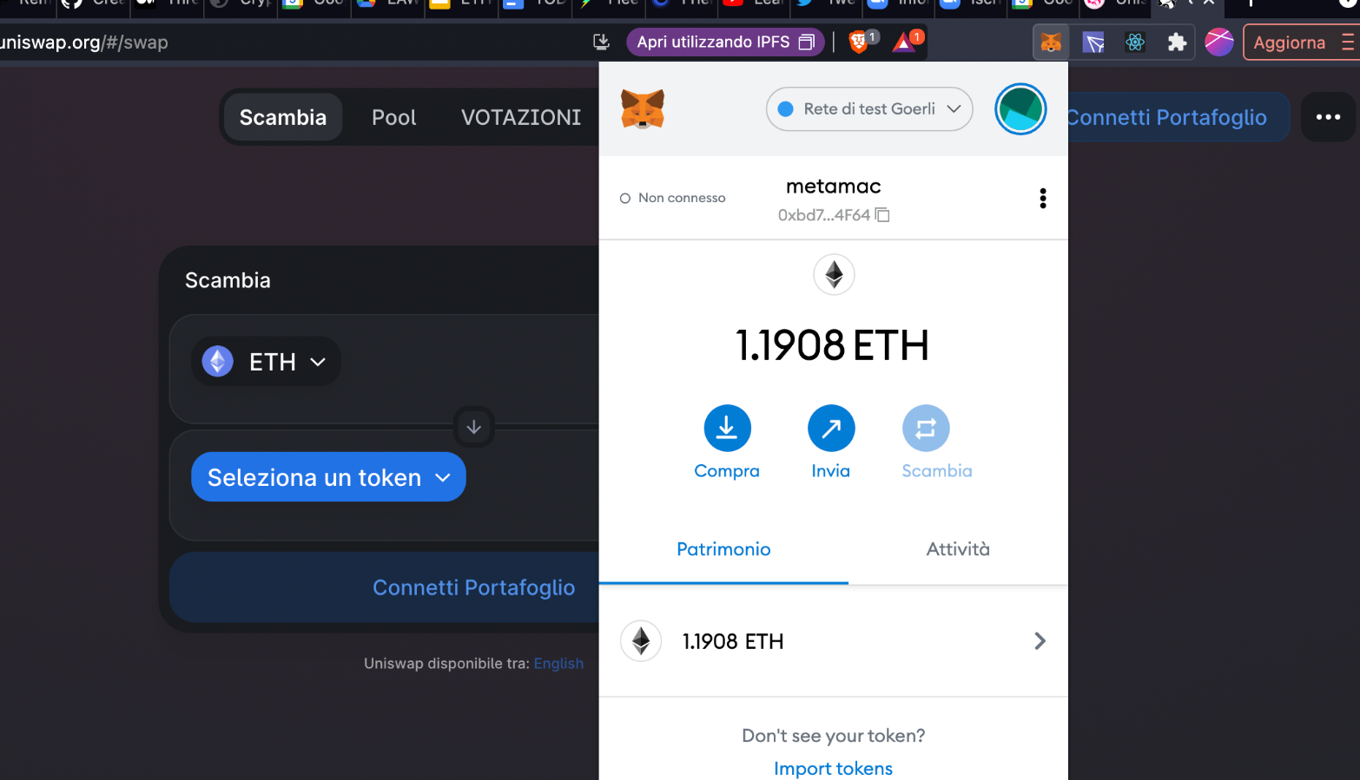
Web3 DAPPs
FRONT END code (React, Html, Css etc.)
“WEB3” code
Decentralized
Storage - IPFS
smart contracts
(Blockchain)
CORP
Centralized Storage

